Slide 1


Managing Spatiotemporal Data Fusion at Scale Using The Geodesic Platform

Slide 2

What IS Geodesic?
Geodesic (n. /jēəˈdesik/): relating to or denoting the shortest possible line between two points on a sphere or other curved surface.
Geodesic Platform (n. /jēəˈdesik platfôrm /): the shortest possible path to answer your questions
Geodesic is the World’s First Decentralized Platform Optimized for Planetary-Scale Spatiotemporal Analytics
Notes:
We’ll of course go into more detail about what exactly Geodesic is, but this is it in a nutshell.

Slide 3


WhY Geodesic?
Geodesic (n. /jēəˈdesik/): relating to or denoting the shortest possible line between two points on a sphere or other curved surface.
Geodesic Platform (n. /jēəˈdesik platfôrm /): the shortest possible path to answer your questions
Geodesic is cloud native and designed from the ground up to efficiently scale to solve planetary scale problems
Achieving this scale on their own is difficult for many organizations
Geodesic is built upon a decentralized data model. We don’t need to own the data to enable it for use
Alternatives must own and manage the data to use it
Often heterogeneous, spatiotemporal data is notoriously complex and difficult to deal with.
Working with it requires expertise and specialized software
Notes:
Geodesic is cloud native and designed to scale. It’s built on a decentralized data model, meaning we don’t have to own petabytes of data to make it usable. Spatiotemporal data is hard, we try to simplify that. Today, I’m going to show you how we work with data in the geodesic platform.

Slide 4
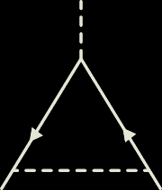



GeodESIC
Tesseract
Entanglement
Spacetime
Boson
Notes:
Geodesic is composed primary of 3 main services Entanglement, Spacetime, and Tesseract, in addition to enabling technology, Boson

Slide 5
GeodESIC
Everything is related, Entanglement shows you how. What is a dataset good for? What questions can it answer?
Tesseract
Entanglement
Spacetime
Boson
Notes:
Entanglement allows us to capture and encode complex graphical relationships and an extensible, logical ontology. Entanglement is version controlled, so you can look at the state of the graph at any point in time.

Slide 6
GeodESIC
Tesseract
Fully version controlled, built on scalable, cloud native graph database technology
Entanglement
Spacetime
Boson
Notes:
Unlike traditional graph analytics and link analysis software, Entanglement’s primary mission is to encode use cases, specifically how data fits together to answer questions – even those you didn’t know you could ask.

Slide 7
GeodESIC
Tesseract
Entanglement
Spacetime
Boson

Slide 8
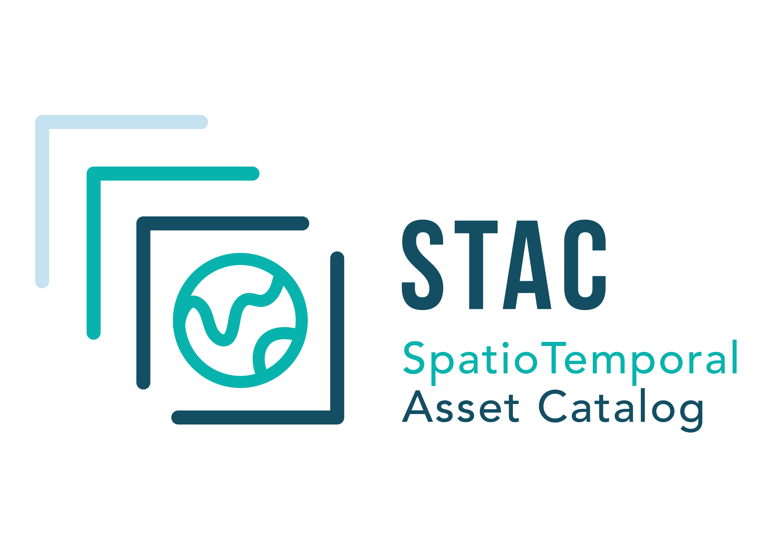
GeodESIC
Tesseract
Entanglement
Spacetime
If it happened at a time or place, Spacetime can help you find it. Scalable data store for disparate spatiotemporal data
Boson
Notes:
Spacetime allows you to search for data any time or place on the earth. Unlike many others that are focused on a particular type of data or expose numerous disparate services, we have adopted the growing Spatiotemporal Asset Catalog spec (STAC) to enable the storage and retrieval of virtually any spatiotemporal data source. We treat data as a decentralized asset, meaning no single entity or organization has authority over the data we enrich and expose.

Slide 9
GeodESIC
Tesseract
Entanglement
Spacetime
Boson

Slide 10
GeodESIC
Tesseract
Petabytes of pixels and other rich spatiotemporal data at your fingertips.
Entanglement
Spacetime
Boson
Notes:
Scaling up, especially for geospatial and spatiotemporal AI models is challenging. We make it simple to manage massive datasets and run sophisticated machine and deep learning models.

Slide 11
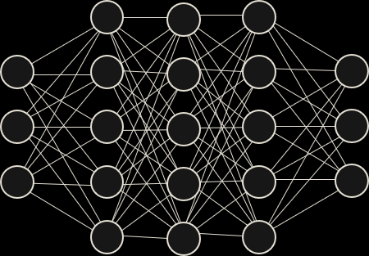
GeodESIC
Tesseract
Data Fusion: Prepare training data, run machine and deep learning, or arbitrary computation at planetary scale
Entanglement
Spacetime
Boson
Notes:
Tesseract is especially optimized for data fusion – bringing multiple disparate datasets together to extract their combine predictive power.

Slide 12
GeodESIC
Tesseract
Entanglement
Spacetime
Boson

Slide 13
GeodESIC
Tesseract
The Geospatial Service Mesh – enabling a decentralized geospatial data infrastructure
Entanglement
Spacetime
Boson
Notes:
Boson is a geospatial service mesh – abstracting away many of the difficulties when talking between multiple geospatial services.

Slide 14
GeodESIC
Tesseract
Plugin-based architecture enables virtually any data source or API to be exposed through virtually any service API
Entanglement
Spacetime
Boson
Notes:
Essentially, disparate APIs and data sources are much less of an issue. I don’t need to work as much about where the data is, as long as there’s a usable service that exposes it.

Slide 15
GeodESIC
Tesseract
Entanglement
Spacetime
Boson

Slide 16
GeodESIC

Slide 17
GeodESIC
?
Notes:
Now I’m going to tell you about the workflow of using the Geodesic platform and the services I just described. It all starts with a question.

Slide 18
GeodesicExample1_Installation
conda environment
install geodesic
api
import & authenticate
Notes:
Now I’m going to tell you about the workflow of using the Geodesic platform and the services I just described. It all starts with a question.

Slide 19
Conda Environment
conda create –n geodesic python=3.8
conda activate geodesic
Create a conda environment for geodesic
Cross-platform package and environment manager
Happy place for specific packages and python versions to run smoothly

Slide 20
Install Geodesic API
1)
conda install GDAL=3.0.1
or
conda install –c conda-forge gdal=3.0.2
GDAL comes first
Used for manipulating geospatial data
pip install geodesic python API to access the platform
2)
pip install geodesic-api[all]

Slide 21
Import & Authenticate
1)
import geodesic
print("geodesic version = ",geodesic.__version__)
In jupyter notebook, import geodesic
Verify version (optional)
Authenticate account information
2)
geodesic.authenticate()

Slide 22
GeodesicExample2_ProjectCreation
create
project
project
permissions
view
datasets
Notes:
Now I’m going to tell you about the workflow of using the Geodesic platform and the services I just described. It all starts with a question.

Slide 23
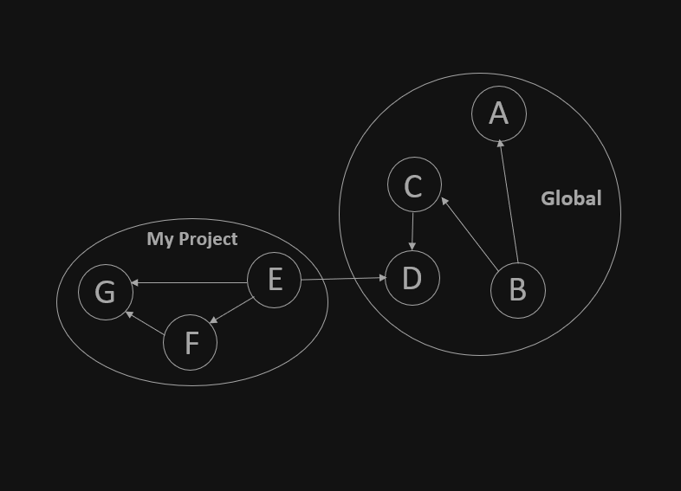
Create a new project
Everything inside Geodesic belongs to a project (subgraph)
Data can be asymmetrically added from the global project
Items inside a project are objects in the subgraph
#Assign parameters for a new project
project= geodesic.Project()
#Create the above project
project.create()

Slide 24
Project Information
1)
#Update permissions for a project
proj = geodesic.get_project('geodesic-example-1’)
proj.update_permission(user='auth0|[user]', permissions={'read':True})
Which projects do I have access to?
Who has access to my projects?
How can I change permissions for projects I own?
2)
#View the projects you have access to
geodesic.get_projects()

Slide 25
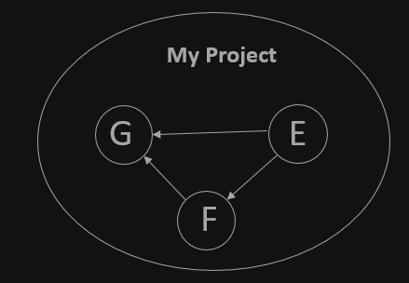
Project Information
What data is inside of my project?
Toggle between projects
View lists of datasets inside of a project
3)
#Set the active project (subgraph) in entanglement
geodesic.set_active_project('geodesic-example-1')
#List datasets in project
datasets = geodesic.list_datasets()
#View output list
datasets

Slide 26
GeodesicExample3_AddData
save
credentials
add
data
view
credentials
Notes:
Now I’m going to tell you about the workflow of using the Geodesic platform and the services I just described. It all starts with a question.

Slide 27
Add Credentials
#Google Earth Engine
gee = geodesic.account.credentials.Credential.from_gcp_service_account(
name='google-earth-engine', key=key)
gee.create()
#Amazon S3
aws = from_aws_key_pair(*, name='aws-s3', aws_access_key_id, aws_secret_access_key=None)
aws.create()
#ArcGIS Online
from_oauth2_client_credentials(*, name='esri-oauth2', client_id, client_secret=None, token_url=None,
authorization_url=None, audience=None, scope=None)
1)
Data can be added from anywhere. For this example we will add data from Google Earth Engine, Amazon S3, and ArcGIS Online.
Some data instances require user credentials while others may not. You can store credential for any of these instances inside of Geodesic

Slide 28
Add Data
2)
#Add Google Earth Engine data
ecmwf = geodesic.Dataset.from_google_earth_engine(
name='ecmwf',
asset='ECMWF/ERA5/MONTHLY',
credential= 'google-earth-engine',
alias='ERA5 Monthly Aggregates',
description='Latest Climate Reanalysis Produced by ECMWF / Copernicus Climate Change Service.'
)
ecmwf.save()
#Add ArcGIS Online data
gis = arcgis.GIS('https://seerai.maps.arcgis.com', username='demo_account’)
naip = geodesic.Dataset.from_arcgis_item(
name='naip-imagery',
item_id='3f8d2d3828f24c00ae279db4af26d566',
credential='esri-oauth2',
gis=gis
)
naip.save()
Once credentials are saved inside of Geodesic a user can use them indefinitely to add data to any project you have access to.
On the right are some examples of using Boson to add data to a project

Slide 29
View Credentials
3)
#Retrieve your user account credentials
geodesic.account.credentials.get_credentials()
As more user credentials are added to Geodesic it may be necessary to reference them.
This is easily done with the one line on the right

Slide 30
GeodesicExample4_ExploringData
retrieve
dataset
query
dataset in
space/time
view
features
Notes:
Now I’m going to tell you about the workflow of using the Geodesic platform and the services I just described. It all starts with a question.

Slide 31
Retrieve dataset
1)
#Get and make a variable out of a particular dataset
ecmwf_ds = geodesic.get_dataset('ecmwf', project='geodesic-example-1')
2)
#Query the dataset in space and time
import pprint
from datetime import datetime
#Assign spatial bounding box. This can be the bounding coordinates of any area on Earth
bbox = [-101.837769,43.953282,-100.936890,44.754535]
#Query the first six months of 2018 data inside the bounding box
ecmwf_query = ecmwf_ds.query(bbox=[-101.837769,43.953282,- 100.936890,44.754535],
datetime=[datetime(2018, 2, 1), datetime(2018,
7, 1)])
Once data exists inside of a project it can be easily accessed, explored, and manipulated.
Because many of these datasets are spread out over space and time it is useful to apply a space/time query when data are accessed
The result of this query will return a feature for each time bin; in this case six features will be returned

Slide 32
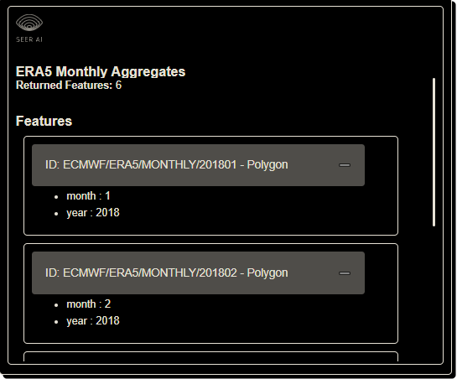
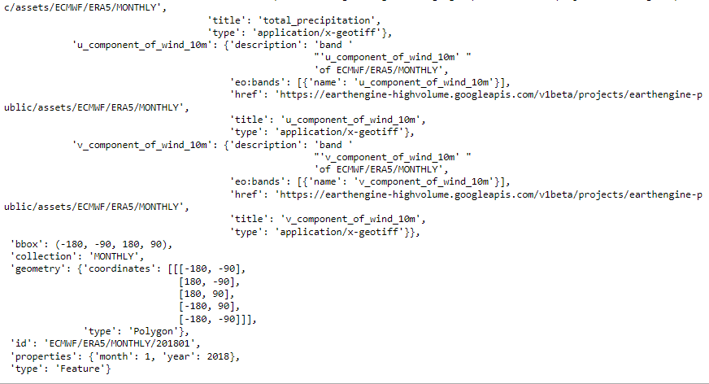
Feature metadata
3)
Each feature has important metadata within it. Querying a feature will return information about its assets, its collection period and its spatial extent
#Assign the first feature (in this case month 1) of the dataset to a dictionary
example1 = dict(ecmwf_query.features[0])
#View output dictionary
pprint.pprint(example1)

Slide 33
GeodesicExample5_UsingData
query
dataset
warp
dataset
plot
array
Notes:
Now I’m going to tell you about the workflow of using the Geodesic platform and the services I just described. It all starts with a question.

Slide 34
Using data
1)
#Assign date variables
start_date = datetime(2018, 1, 1)
end_date = datetime(2018, 2, 1)
datetime = [start_date, end_date]
#Assign the predipitation dataset to an array
ecmwf_array = ecmwf_ds.warp(bbox=bbox, datetime=datetime,bbox_srs='EPSG:4326', output_srs='EPSG:3857',
asset_names=['total_precipitation'], pixel_size=(500.0, 500.0)
)
#View output array shape
print("Array shape:", ecmwf_array.shape)
#View image
import plotly.express as px
import numpy as np
img = ecmwf_array[0]
fig = px.imshow(img, labels=dict(x="Monthly Rainfall Total for January, 2018", color="Rainfall Totals (meters)", ))
fig.update_xaxes(side="top")
fig.show()
Accessing and viewing datasets and metadata is important but we want to do something with these data.
Once a dataset is queried it can be easily passed to a numpy array and plotted in any number of ways

Slide 35
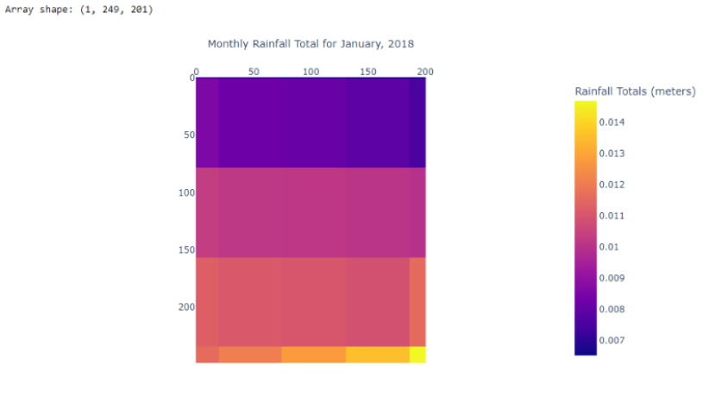
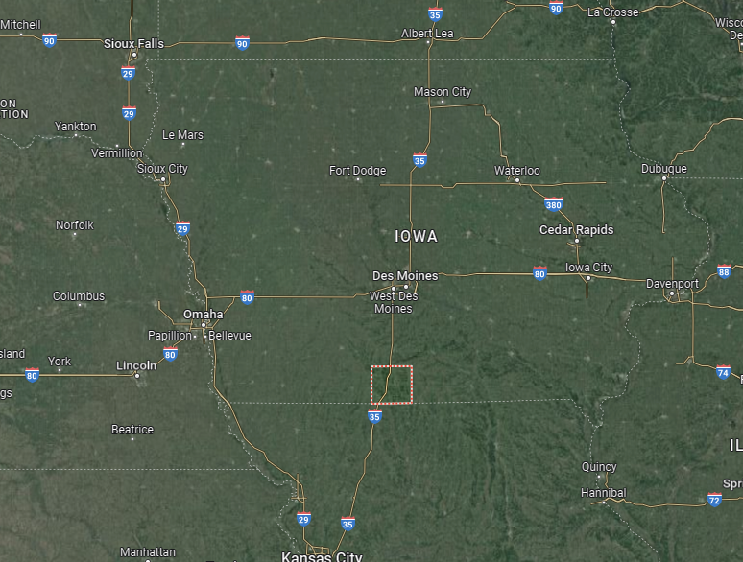
Output

Slide 36
GeodesicExample6_TesseractBasic
concept
job
specs
output
arrays
Notes:
Now I’m going to tell you about the workflow of using the Geodesic platform and the services I just described. It all starts with a question.

Slide 37
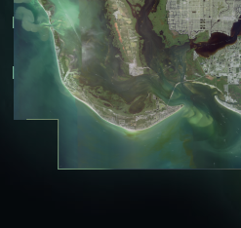
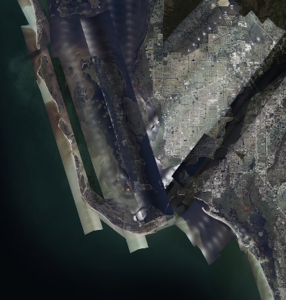
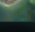
Concept – Data Enrichment
Tesseract allows users to combine disparate datasets at massive scales and to align them in space and time
This is useful for many applications but particularly for machine learning
Aligned pixels from different sources can be used as inputs to predict some target pixel from another data source
Time Range: 2016-2019
Resolution: 500m:
Time Range: 2017-2020
Resolution: 30m:
Y
X2
X3
X1

Slide 38
Job Specs
#Spec Tesseract job
from geodesic.tesseract import Job, AssetSpec, GlobalProperties, TemporalBinning
from datetime import datetime
bbox = [-101.837769,43.953282,-100.936890,44.754535]
job_spec = {
'name': 'geodesic-example-1-tesseract-job',
'alias': 'geodesic example 1 Tesseract Job',
'description': 'A demo job to show how tesseract can combine USDA CDL and global precipation data',
'bbox': bbox,
'project': 'geodesic-example-1',
'bbox_epsg': 4326,
'output_epsg': 3857,
'workers': 1,
'asset_specs': [
{
'dataset': 'ecmwf',
'name': 'ecmwf',
'project': 'geodesic-example-1',
'assets': ['total_precipitation'],
'pixel_size': [500.0, 500.0],
'resample': 'bilinear',
'datetime': (datetime(2016,1,1), datetime(2018,7,1)),
'temporal_binning': {
'equal': {
'bin_size': '365D'
}
}
},
{
'dataset': 'nasa-grace-conus-soil-moisture',
'name': 'grace',
'assets': ['surface_soil_moisture', 'drought_index'],
'pixel_size': [500.0, 500.0],
'resample': 'bilinear',
'datetime': (datetime(2016,1,1), datetime(2018,7,1)),
'temporal_binning': {
'reference': 'ecmwf'
}
},
],
'steps': [
]
}
Tesseract job specs allow you specify:
The output dataset name
The output dataset pixel size
The output dataset time bin
The output dataset resampling technique
The output dataset daterange
Duplicating these specifications between datasets allows them to be aligned for modeling, raster math, ect.

Slide 39
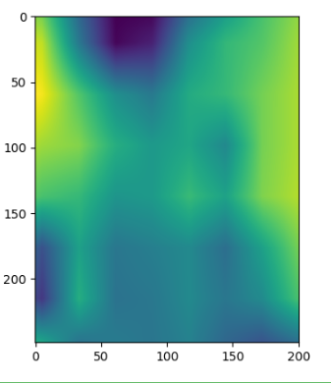
Output Arrays
Use Geodesic's zarr function to return the zarr group for the job output. 'Zarr is a format for the storage of chunked, compressed, N-dimensional arrays'. (https://gdal.org/drivers/raster/zarr.html)
We can then view the output of the job
#View the output of the tesseract job
#Calculate percent away from the mean for each pixel
data = 1-((tess)/np.mean(tess))
#Reshape result to plot
image = data[1,0,:, :]
plt.imshow(image)
#View zarr file info
zf = job.zarr('ecmwf')
zf.info
From the zarr output we can call the tesseract array.
import matplotlib.pyplot as plt
import numpy as np
tess = zf['tesseract']
tess.shape

